Slide 1

Agenda
Roll call
Status roundtable
Functional Area Review
Schedule review
Upcoming Votes
HIT Connect Conference Summary
Open Discussion

Slide 2
Roll Call
Member | Present?
Blu Strategies Consulting | No
Coherence | No
CMS | No
General Dynamics IT | Yes
HealthTech Solutions | No
KRM Associates | No
MITRE | Yes
MTA | No
Social Interest Solutions | Yes
Vermont | Yes
West Virginia | No
WEX Health | No
Wily Fox | Yes

Slide 3
Status Roundtable - MITRE
Last two weeks:
Poplin was discussed in many venues at HIT Connect
Presented Poplin to MTA meeting at HIT Connect
Roundtable session on Poplin at HIT Connect was well attended
Coherence and Wily Fox joined the Poplin Working Group!
Met with Pega Systems and Magellan at HIT Connect – likely to join!
Added new member to the MITRE Poplin team (Andrew Schreiber)
Data Standard Taxonomy meetings and Claims kickoff meeting
Continued MITRE security service definition reviews
This week:
Wrap up MITRE reviews of security shared service definition
First round approvals for MITRE project plan April through September
Blockers: None

Slide 4
Status Roundtable – Vermont
Last two weeks: Tied up in updating our MITA State Self-Assessment, Reviewing SoV’s Provider Management Module expected implementation, working on our Health Information Exchange and EHR data issues. Hope to be able to bring some of this work to the table here.
This week: Vacationing in Florida
Blockers: Time

Slide 5
Status Roundtable – West Virginia
Last two weeks: We have run into some bandwidth issues due to urgent SOWs that we have received.
This week: We hope to remediate the issue and let you know soon.
Blockers: Urgent SOWs

Slide 6
Status Roundtable – WEX Health
Last two weeks:
This week:
Blockers:

Slide 7
Status Roundtable – Blu Strategies
Last two weeks:
This week:
Blockers:

Slide 8
Status Roundtable - KRM Associates
Last two weeks:
This week:
Blockers:

Slide 9
Status Roundtable – HealthTech Solutions
Last two weeks:
This week:
Blockers:

Slide 10
Status Roundtable – Social Interest Solutions
Last two weeks: Attended review meeting for Data Services definition.
This week: Will put together our thoughts and collaborate with partners on work breakdown around DW/BI/Analytics track.
Blockers: None

Slide 11
Status Roundtable - GDIT
Last two weeks: Eric still reviewing Identity Management
This week: Renjith Nair on Claims
Blockers: Competing priorities

Slide 12
Status Roundtable - MTA
Last two weeks:
This week:
Blockers:

Slide 13
Status Roundtable – Wily Fox
Last two weeks: Initial Discussion around approach to decompose the Claims Area.
This week: Review claims area decomposition matrix and determine assignments.
Blockers: None

Slide 14
Status Roundtable - Coherence
Last two weeks: Initial Discussion around approach to decompose the Claims Area- Accomplished
This week: Planned Action Item: Develop the Initial Claims Area decomposition matrix of for the team review and assignment.
Blockers: None

Slide 15

Functional Areas Divide and Conquer Approach
Functional Area | Covered | Member
Case Management |  | Vermont
Claims |  | Wily Fox, Coherence, CSRA
Data Warehouse / Business Intelligence / Analytics |  | Blu Strategies, Social Interest Solutions, HealthTech Solutions
Financial Management |  | WEX Health
Identity Management |  | CSRA
Member Eligibility |  | West Virginia
Pharmacy |  | MITRE
Shared Services: Messaging, Registration/Discovery, Security |  | MITRE
Third Party Liability |  | KRM Associates
Managed Care Enrollment Broker | OPEN
Member Enrollment | OPEN
Provider Screening | OPEN
Provider Enrollment | OPEN
15

Slide 16
Poplin Working Group Schedule
Poplin Member | Deliverable | Due Date
WEX Health | Financial Management: State Plan Remittance Service Definition | March 2, 2018
West Virginia | Eligibility Service Definitions - Draft | March 16, 2018
Blu Strategies, Social Interest, HealthTech | Data Service Taxonomy – Final Candidate | April 20, 2018
Vermont | Case Management: Client/Member Management Service Definition Draft | April 27, 2018
Vermont | Case Management: Service Management Service Definition Draft | April 27, 2018
Vermont | Case Management: Eligibility and Enrollment Service Definition Draft | April 27, 2018
Blu Strategies, Social Interest, HealthTech | Data Warehouse / Business Intelligence / Analytics Service Definitions | Pending analytic taxonomy strategy approval
KRM Associates | Third Party Liability Service Definitions – Draft | TBD
CSRA | Identity Management Service Definitions - Draft | TBD

Slide 17
Upcoming Votes
Like to have discussion for each of these started on GitHub issue tracker
https://github.com/MITA-Governance-Board/Poplin/issues
Review documents on Data Service Taxonomy and provide feedback
https://github.com/MITA-Governance-Board/Poplin/tree/master/service_definitions/analytics
Vote for Step 1 approval at April 20th meeting for wider distribution (Step 2).

Slide 18
HIT Connect Conference
Rebranded “Poplin Reference Architecture” as “Poplin APIs”
A lot of buzz at the conference around Poplin APIs
Several vendors and states commented that “Poplin was everywhere”
Distributed over 200 Poplin buttons
Poplin team lunch!

Slide 19
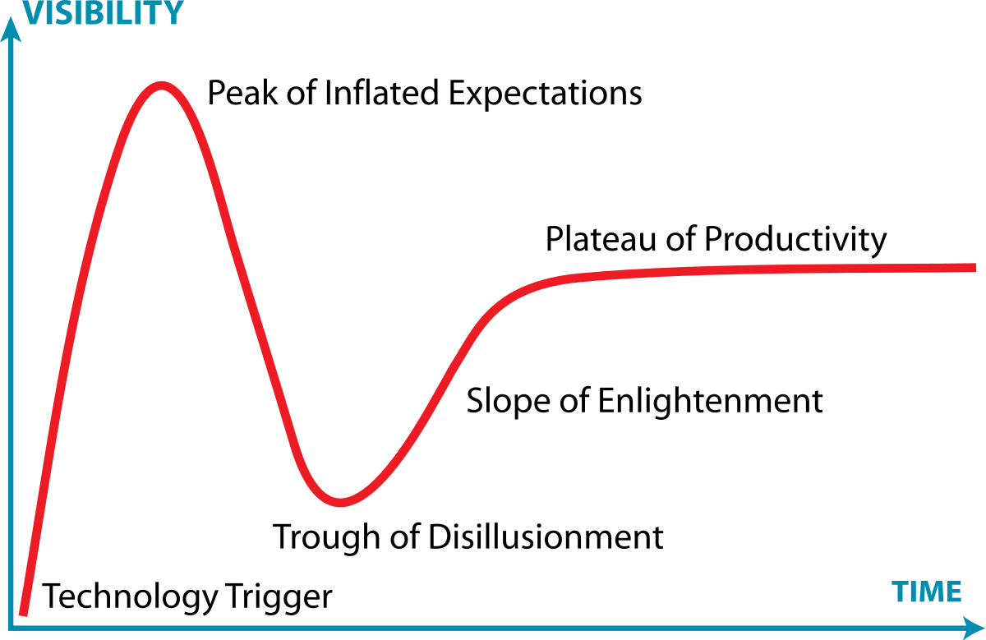
Poplin APIs on Gartner Hype Curve
After
HIT Connect
Before
HIT Connect

Slide 20
HIT Connect Conference MTA Meeting
Presented Poplin API update at MTA meeting
Questions from Poplin presentation
How does data flow from the existing MMIS system (discussion of legacy system as part of the orchestration of services in the modular environment)
Discussion of business needs driving the technology versus the other way around.
Other top questions
How do States do vendor management of so many players? They don’t have disciplined project management offices.
The "what, when, and how" of modular certification
How to address the variability in the interpretation of the Systems Integrator role

Slide 21
HIT Connect Conference Poplin APIs Roundtable
Poplin APIs breakfast roundtable was very well attended
How do states move forward to align with Poplin APIs?
What open standards and long-term plan regarding standards already in place?
Where and how does security fit in?

Slide 22
HIT Connect Conference Other Sessions Highlighting Poplin APIs
Pre-certification Pilot
Modular Modernization
MITA Governance Board

Slide 23
HIT Connect Conference Key Takeaways for Poplin Project
The Poplin project has arrived!
A lot of new attention from States, vendors, and CMS
Project has entered a new stage!
Evangelizing -> Delivering
With more attention, more scrutiny
Need to deliver service definitions to avoid trough of disillusionment
How can we deliver service definitions more quickly?

Slide 24
Proposed Changes to Service Definitions
Prioritize elements of the service definition
New focus on resource and API definitions
Proposed new priorities
Before:
• Business Process Diagrams
• Object Diagrams
• Resource Definitions
• API Definitions
• Message Definitions
After:
• Business Process List
• Resource Definitions
• API Definitions
• Message Definitions

Slide 25
Open Discussion

